Slide 1
Lecture 1: Basic R programming
Nov 14,2021

Slide 2
Vector-based language: R for statistical computing
Created by the statistician John Chambers, with its original precursor being S
Object & functions
Components of a function
Packages
Base packages
User-written packages (e.g., Tidyverse)
Key functions (Rstudio exercise!)
install.packages(“X”)
library(X)
*require(X)
help(X) # but also googling, stackoverflow.
?(X)

Slide 3
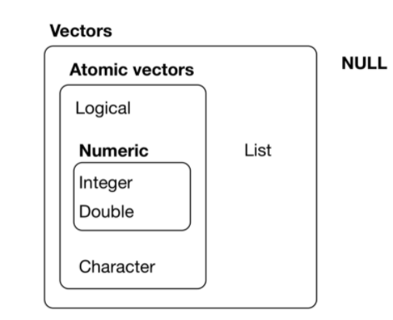
Create objects in R (ch 20 r4ds)
Object types
(Atomic) vector
Numeric (including numbers, matrix, array), characters, logical
Lists (“recursive vector”): Could contain vectors and mix different types of vectors
Null
“Augmented vectors” /Important classes
Data frame (key!)
Dates
Factors
Key functions (Rstudio exercise!)
*typeof(X) #used slightly less
class(X)
length(X)
dim(X)
str(X)
summary(X)
*matrix(X)

Slide 4

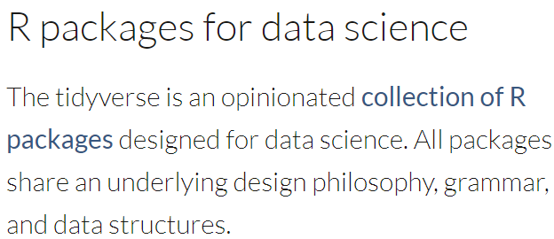
More on data frames
Rows: observations
Columns: variables, attributes
‘Tidy data’ & tidyverse
class: data frame; tibble
Key functions:
data.frame()
tibble() # may have pros & cons, convert back to data.frame if something doesn’t work (supposedly they should)

Slide 5
Three key symbols/functions + one more
<- (or “=“)
Assignment
c(X)
Combine
$
“dollar sign” for extracting elements from a data.frame (and a list too)
%>%
“pipe” (will discuss more later)

Slide 6
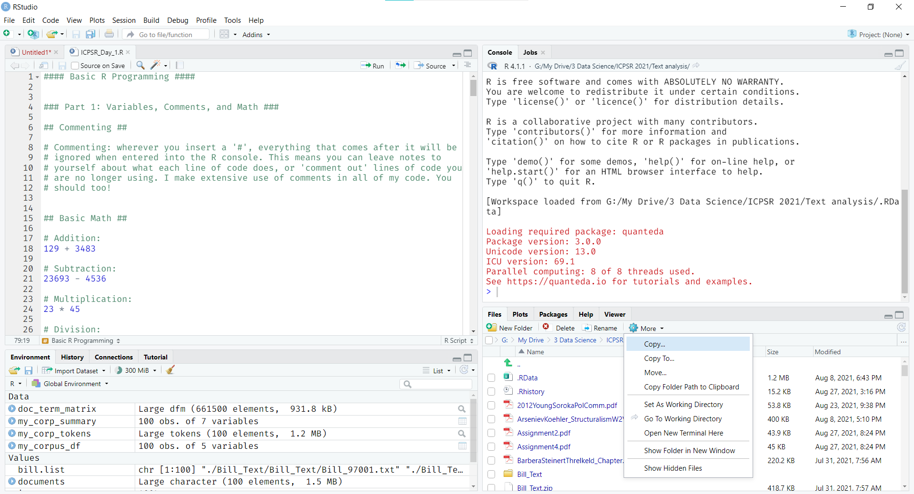
Working directory & data import

Slide 7
Indexing and Subsetting
How do I extract/access the 5th element of a numeric vector?
How do I extract/access the 2nd row, 2nd column of my df?
How do I extract/access all elements in the 2nd column/row of my df?
How do I extract/access all elements from the 2nd to the 4th row of my df?
Key functions/symbols:
Base R solution: df[,]
Tidyverse solution:
filter(); select()

